Slide 1
Notes 6-1:
AWS Database Services
SYS-360

Slide 2
Advantages of Cloud Databases
Fully Managed: services relieve many of the setup, management, and monitoring responsibilities off of the business’s shoulders.
Scalable: Databases that can be highly scalable when compared to on-premise systems
Highly available: Given its global infrastructure setup and fault tolerance mechanism, Cloud providers (AWS, Azure…) provide highly available services across the globe.
Security: Highly secure services due to the implementation of multi-level security systems like network isolation and end-to-end encryption.

Slide 3
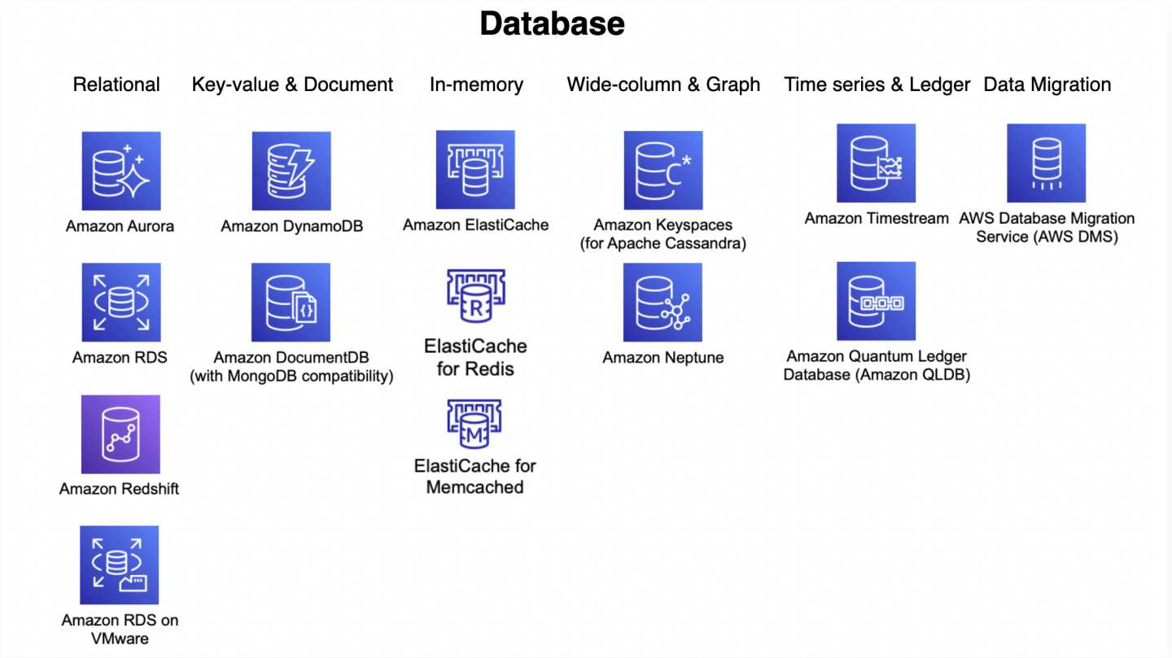
AWS Database Services

Slide 4
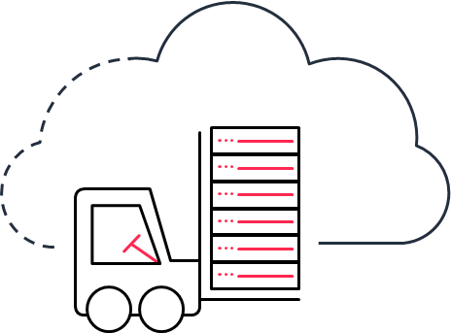



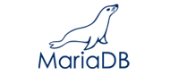


Amazon Relational Database Service (RDS)
Managed relational database service with a choice of six popular database engines
Easy to administer
Available and durable
Highly scalable
Fast and secure
No need for infrastructure provisioning, installing, and maintaining DB software
Automatic Multi-AZ data replication; automated backup, snapshots, failover
Scale database compute and storage with a few clicks with no app downtime
SSD storage and guaranteed provisioned I/O; data encryption at rest and in transit
Notes:
Customers that are running commercial databases such as Oracle and SQL Server on premises often choose to first migrate to Amazon RDS, a fully managed relational database service that you can use to run your choice of database engines including open source engines as well as Oracle, and SQL Server. Amazon RDS improves database scale and performance and automates time-consuming administration tasks such as hardware provisioning, database setup, patching, and backups.

Slide 5












































Hundreds of thousands of customers use Amazon RDS
Notes:
Because of its ease of use, high availability and cost-effectiveness, Amazon RDS has hundreds of thousands of customers today.

Slide 6
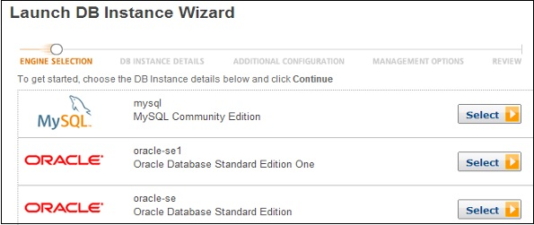
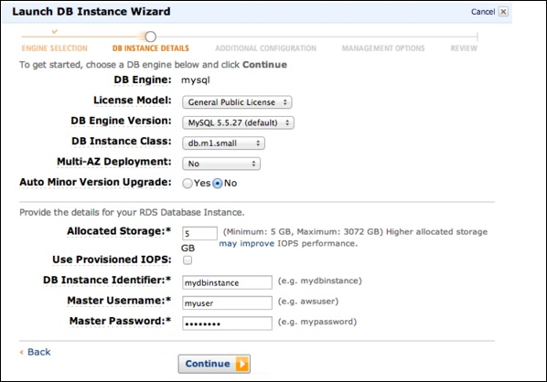
AWS RDS Pricing

Slide 7
Amazon Aurora
MySQL and PostgreSQL-compatible relational database built for the cloud
Performance and availability of commercial-grade databases at 1/10th the cost
Performance and scalability
Availability and durability
Highly secure
Fully managed
5x throughput of standard MySQL and 3x of standard PostgreSQL; scale-out up to 15 read replicas
Fault-tolerant, self-healing storage; six copies of data across three Availability Zones; continuous backup to Amazon S3
Network isolation, encryption at rest/transit
Managed by RDS: No hardware provisioning, software patching, setup, configuration, or backups
Notes:
That's why we spent a few years building Amazon Aurora.
Up to 64TiB of auto-scaling SSD storage
Up to 15 Read Replicas with sub-10ms replica lag
Automatic monitoring and failover in less than 30 seconds.
Da 1 vCPU 2Gb di RAM a 48vCPU, 384GB RAM

Slide 8
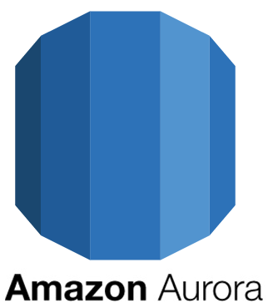
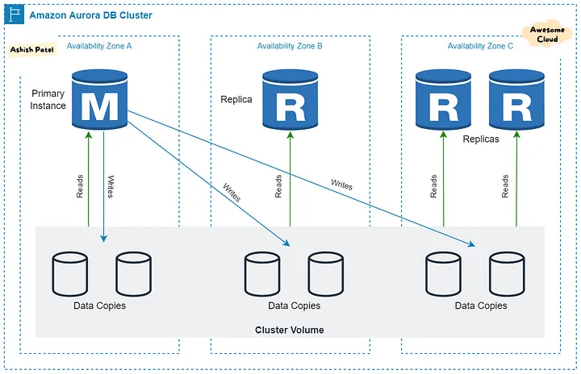
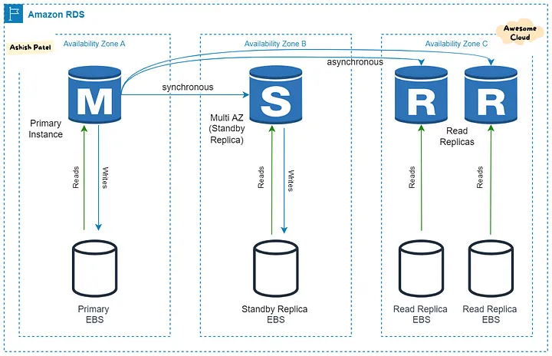
Amazon Aurora vs RDS
Aurora is a proprietary database engine developed by AWS. Aurora is compatible with MySQL and PostgreSQL
Performance:
RDS: Offers good performance for standard database workloads.
Aurora: Provides significantly better performance
Architecture:
RDS: single-instance architecture where one instance serves the application's read and write requests.
Aurora: Aurora Storage, which is distributed and replicated across multiple Availability Zones (AZs).
Replication:
RDS: Traditional read replicas that can be used to offload read traffic from the primary database instance.
Aurora: Distributed storage architecture that replicates data across multiple Replicas in different AZs.

Slide 9
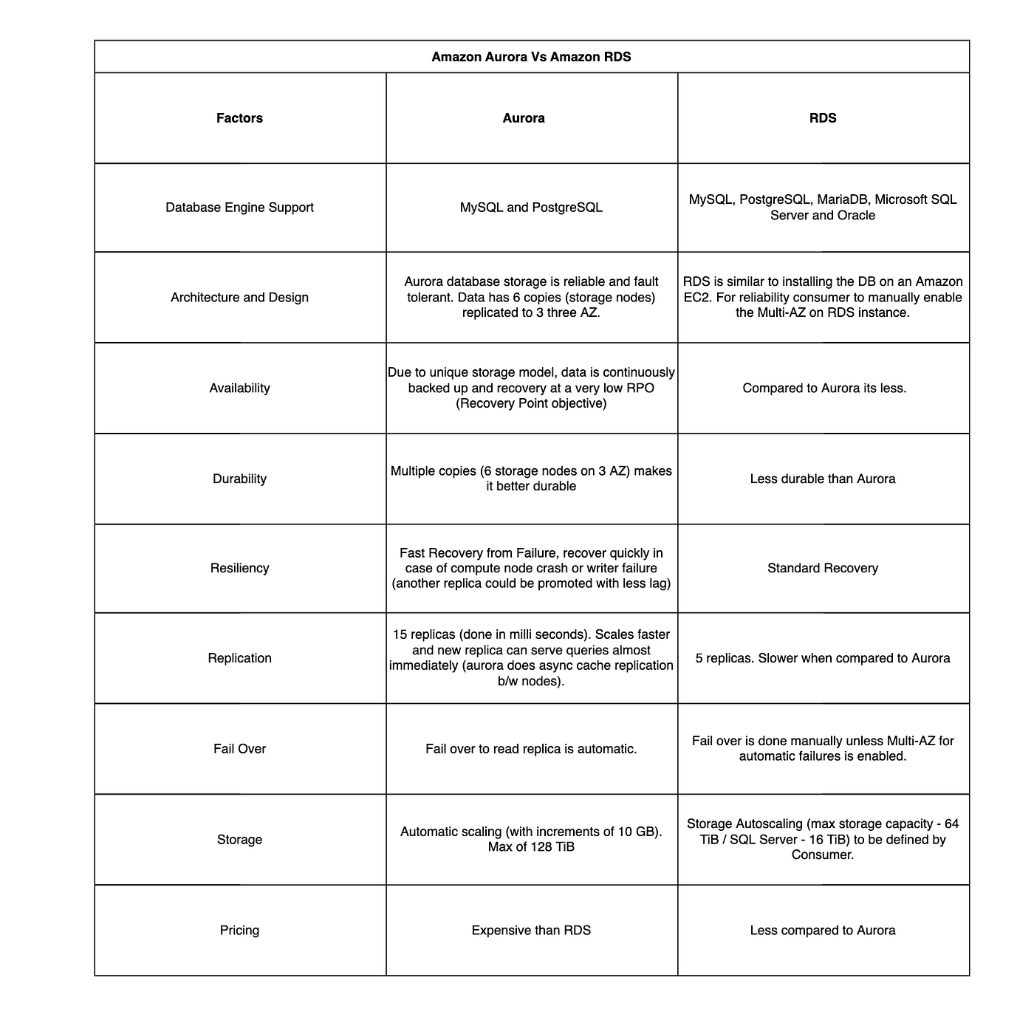
AWS Aurora vs RDS cont…
Failover:
RDS: Offers Multi-AZ deployments, where a standby replica is maintained in a different AZ to provide automatic failover in case of a primary instance failure.
Aurora: Provides automatic failover with faster recovery times compared to Multi-AZ deployments. Aurora replicas are used for read scaling as well as for failover purposes.
Storage and Scalability:
RDS: Based on selected database engine's characteristics and limits.
Aurora: Storage capacity can grow dynamically up to 128 TB.
Price:
RDS: Cost is generally lower compared to Amazon Aurora,
Aurora: Typically costs more than RDS due to its better performance

Slide 10
Amazon Aurora
NEW Features:
Aurora Global Database
Aurora Serverless
Aurora Parallel Query
Designed for globally distributed applications, allowing a single database to span multiple AWS regions
On-demand, auto-scaling configuration; the database automatically starts up, shuts down, and scales capacity up or down on your application's needs.
Faster analytical queries over your current data. It can speed up queries by up to 2 orders of magnitude, while maintaining high throughput for your core transactional workload
Notes:
AURORA GLOBAL DATABASE:
It replicates your data with no impact on database performance, enables fast local reads with low latency in each region, and provides disaster recovery from region-wide outages.
AURORA SERVERLESS:
It enables you to run your database in the cloud without managing any database instances. It's a simple, cost-effective option for infrequent, intermittent, or unpredictable workloads.
AURORA PARALLEL QUERY:
While some databases can parallelize query processing across CPUs in one or a handful of servers, Parallel Query takes advantage of Aurora’s unique architecture to push down and parallelize query processing across thousands of CPUs in the Aurora storage layer. By offloading analytical query processing to the Aurora storage layer, Parallel Query reduces network, CPU, and buffer pool contention with the transactional workload.

Slide 11












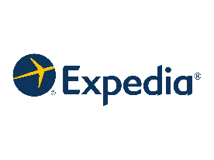




























Aurora
: fastest growing service in AWS history
Notes:
Tens of thousands of AWS customers use Amazon Aurora for their relational databases – a number that has more than doubled from November 2017 to November 2018
Customer success stories provided as reference:
One example is FINRA. FINRA is one of the largest independent securities regulators in the United States, is they’re using DMS to move their databases that ingest and store billions of financial transaction records from Oracle to Aurora for greater performance at lower cost, leveraging AWS database technologies for capturing and storing a daily influx of more than 75 billion financial records.
Another example is Dow Jones. Dow Jones migrated its legacy databases onto Amazon Aurora allowing the company to be more efficient, cost-effective and secure.
Dow Jones first legacy on-prem database to Aurora migration went live the week of May 2017 at Dow Jones. This high-profile workload plays a critical role in engaging and retaining their customers. News is an early adopter of Aurora; Dow Jones and AWS worked together over the last year with direct access to the Aurora service team and GM to build confidence and expertise in the platform. A series of AWSome days delivered by AWS emphasized Aurora and included demonstration of its cutting-edge Lambda integration, as well as the AWS Database Migration Service, which Dow is utilizing to move data from its legacy on-prem environment to Aurora.
With this first migration, Ramin Beheshti, Dow Jones Chief Product and Technology Officer, said “This is such an awesome step for all of us. Newsletters play a critical business role in engaging and retaining our users. This move not only gets us off really old tech, but it will allow us to move much quicker with new newsletters and enable us to onboard new newsletter providers – which we are already doing. It will also make sending newsletters much more reliable and scalable. This migration to AWS Aurora allowed Dow Jones to replace a legacy platform with performance challenges that required 400k in DBA staff to manage with $1M in licensing costs annually to a cloud based highly scalable and resilient solution on AWS Aurora using a 1T Aurora cluster in Virginia with 200 transactions per second along with replication of data to Oregon for high availability and disaster recovery.
Dow Jones’ extensive legacy on-prem environment was expensive, failure prone and inflexible. By moving much of the operational overhead to AWS, and eliminating the need to manage storage completely, Aurora frees up funds for innovation. Traditionally, relatively minor failures in their legacy on-prem database environment have resulted in a manual fail-over to a secondary Dow Jones facility; with its multi-AZ architecture, Aurora provides comparable multi-site resiliency with automated, seamless failover, augmented by six-way replication within an AWS region and replication across regions for a third disaster-recovery option.
With training and guidance from AWS, Dow Jones executed the migration themselves as part of a larger strategic data center consolidation & cloud migration initiative with AWS. This migration is the first of many; News Corp overall is migrating 1100 application to AWS with a focus on managed services.
Another example is Verizon. Verizon is undergoing a major transformation in its database-management approach, moving away from expensive, legacy commercial database solutions (Oracle) to more efficient and cost-effective options (Amazon Aurora). Verizon is a global leader delivering innovative communications and technology solutions. Verizon already runs several of its production business and customer applications on AWS, including several applications that the company has moved off of Oracle databases to Amazon Aurora. Verizon used the AWS Database Migration Service and Schema Conversion Tool to identify areas for data conversion that required special attention during migration.
------------------------------------------------
Capital One, a leading information-based technology company and digital banking innovator, has taken a cloud-first approach to software development. “At Capital One, our cloud-first approach led us to start testing the preview of Amazon Aurora’s PostgreSQL compatibility in November 2016,” said John Andrukonis, Chief Architect, Capital One. “We anticipated performance benefits, as well as the high availability and fast failover capabilities ideal for serving our customers. In our testing during the preview, we’ve been impressed with the performance and high availability offered by Amazon Aurora.”
FINRA regulates a critical part of the securities industry – brokerage firms doing business with the public in the United States. FINRA takes in up to 75 billion market events per day that are tracked, aggregated, and analyzed for the purpose of protecting investors. "FINRA is in the process of migrating most of our relational databases to AWS," said Saman Michael Far, Senior Vice President & CTO, FINRA. "We have evaluated Amazon Aurora with PostgreSQL compatibility, and we look forward to increasing our usage, because PostgreSQL is the best destination for our relational database workloads."
INRIX is the global leader in connected car services and transportation analytics, a new approach that leverages big data and the cloud to help manage urban mobility. "From raw GPS points, INRIX generates large-scale vehicle movement data and ingests the data into sharded Amazon Relational Database Service for PostgreSQL instances. We are hitting the storage and performance limits per shard and looking for a more scalable solution," said Trang Nguyen, Senior Software Engineer, INRIX. "With Amazon Aurora’s compatibility with PostgreSQL, we’ve seen three times performance improvements in our benchmarks. We love Amazon Aurora’s ability to scale storage independently of computing resources at better price points."
Nielsen is a global data management company providing a comprehensive understanding of consumer behaviors. "In our testing of Amazon Aurora PostgreSQL in the preview, we have seen very good performance upwards of 7-11 times that of RDS PostgreSQL, for both write and read/write workloads,” said Todd Lightbody, Watch Architecture Leader, Nielson. “We are also excited about the expected scalability and reliability, giving us great confidence that Amazon Aurora PostgreSQL will meet our requirements as we move some of our core database workloads to AWS.”
Verizon is a global leader delivering innovative communications and technology solutions. “Verizon is helping our customers build a better, more connected life. As part of this journey, we are undergoing a major transformation in our database management approach, moving away from expensive, legacy commercial database solutions to more efficient and cost-effective options,” said Shashidhar Sureban, Associate Director, Database Engineering, Verizon. “Testing of Amazon Aurora PostgreSQL showed better performance over standard PostgreSQL residing on Amazon EC2 instances, and the AWS Database Migration Service and Schema Conversion Tool were found effective at identifying areas for data-conversion that required special attention during migration.”
FantasyDraft is a daily fantasy sports site offering fantasy play across multiple sports and contest formats including leagues, head-to-head contests and tournaments. “We’ve been extensively testing the preview of the new Amazon Aurora PostgreSQL engine, and have been very impressed with overall compatibility with standard PostgreSQL, along with the ease of migrating our data and applications to Amazon Aurora’s new engine to obtain improved performance, scalability and resiliency,” said Tim Weisbrod, FantasyDraft Co-Founder and President. “We are most excited about improved performance under high concurrency workloads to ensure our users have the best experience possible in the final minutes leading up to when contests start. We’re also looking forward to the rapid crash recovery and fast failover capabilities of Amazon Aurora PostgreSQL to ensure any potential disruptions to our customers are minimized, and to Amazon Aurora read replica scale-out and dynamic auto-scaling storage to help us dynamically add resources to cover the busiest times and reduce costs when they aren’t needed.”
OpenSCG is one of the leading solutions partners in the PostgreSQL community. “We have been testing the preview of Amazon Aurora’s PostgreSQL compatibility as part of our goal of helping enterprises successfully move from expensive on-premises commercial relational databases to PostgreSQL,” said Denis Lussier, CEO of OpenSCG. “We are impressed with the PostgreSQL compatibility, the performance, and the high availability, and we are working with multiple customers to give them all the assistance they need to move their Oracle database workloads to Amazon Aurora. It is truly amazing how quickly people are moving past the Oracle RAC objection that I've seen for the last 15 years when they hear how Amazon Aurora works. It's a game changer for sure.”
SRA OSS is part of SRA Inc., one of Japan's oldest and largest systems integration companies. "In our performance testing of Amazon Aurora’s PostgreSQL compatibility, we found that the performance was three times better than standard PostgreSQL," said Tatsuo Ishii, SRA OSS, Inc. Japan President. "Our testing also showed that Amazon Aurora is fully compatible with PostgreSQL 9.6, and we believe customers will be able to move large enterprise workloads from on-premises commercial databases to Amazon Aurora because of its high performance, high availability, and PostgreSQL compatibility. SRA OSS will add support for Amazon Aurora to the next version of pgpool-II, which provides clustering management middleware for PostgreSQL."

Slide 12
Customers are creating new apps in the cloud …
Quickly build new apps in the cloud
Notes:
In addition to customers who want to ‘Lift and Shift’ their applications to the cloud, many customers are building new applications, and want to accelerate their ability to innovate by building data-driven applications in the cloud.

Slide 13
Modern apps create new requirements
Users: 1 million+
Data volume: TB–PB–EB
Locality: Global
Performance: Milliseconds–microseconds
Request rate: Millions
Access: Web, mobile, IoT, devices
Scale: Up-down, Out-in
Economics: Pay for what you use
Developer access: No assembly required
Ride hailing
Media streaming
Social media
Dating
Notes:
For building new apps in the cloud, application requirements are changing, and a one-size-fits-all approach of using a relational database as the only data store for your application no longer works. Traditional applications like ERP, CRM, e-commerce needed relational databases to log transactions and store structured data typically in the GBs and occasionally TBs in size.
New applications that have social, mobile, IoT and global access requirements provide a new set of requirements. These applications need the database to store TBs to PBs of new types of data, provide access to the data with millisecond latency, process millions of requests per second, and scale to support millions of users anywhere in the world.
----Alternate talking points (Note: Skip the next slide if you are using these talking points)------
A one size fits all approach of using a relational database as the only store for your application no longer works. Instead, developers are doing what they do best: breaking complex applications into smaller pieces and then picking the best tool to solve each problem. This ensures that the applications are well architected and scale effectively. The best tool for a job usually differs by use case, so developers are now building highly distributed applications using a multitude of purpose-built databases.
They need databases that can store TBs to PBs of new types of data, provide access to the data with millisecond latency, process millions of requests per second, and scale to support millions of users anywhere in the world. Developers have to choose between relational, key-value, document, graph, and in-memory databases, and need to understand which database type to use when. They need the right tool for the right job.

Slide 14
Developers are doing what they do best
Break complex apps into smaller pieces and pick the best tool to solve each problem
This ensures that the apps are well architected and scale effectively
Developers are now building highly distributed apps using a multitude of purpose-built databases
Notes:
A one size fits all approach of using a relational database as the only store for your application no longer works. So developers are doing what they do best: breaking complex applications into smaller pieces and then picking the best tool to solve each problem. This ensures that the applications are well architected and scale effectively. The best tool for a job usually differs by use case so developers are now building highly distributed applications using a multitude of purpose-built databases.

Slide 15

Work backward from the problem you are trying to solve
Choose the right tool for each job

Slide 16
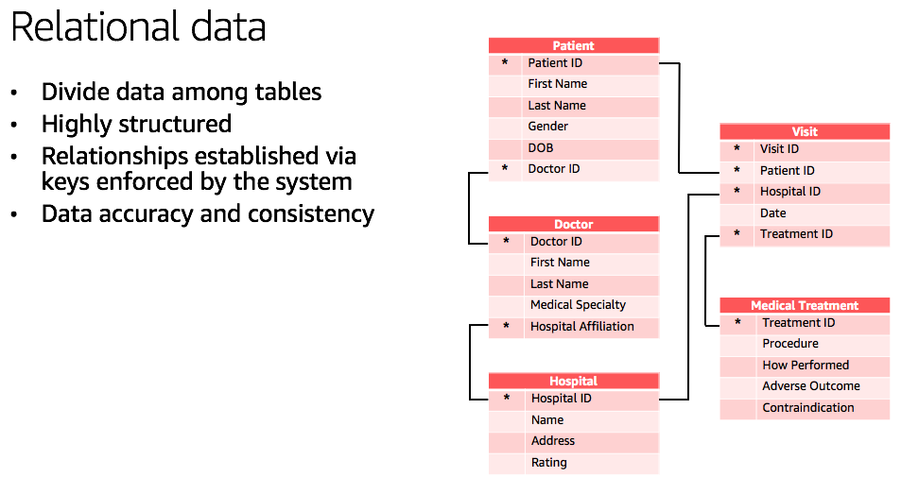
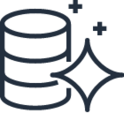
Common data categories and use cases
Relational
Referential integrity, ACID transactions, schema- on-write
Common Use Cases
Lift and shift, ERP, CRM, finance
AWS
Service(s)
Aurora, RDS
Notes:
Strict data modeling.
When I need consistency, accuracy, integrity.

Slide 17
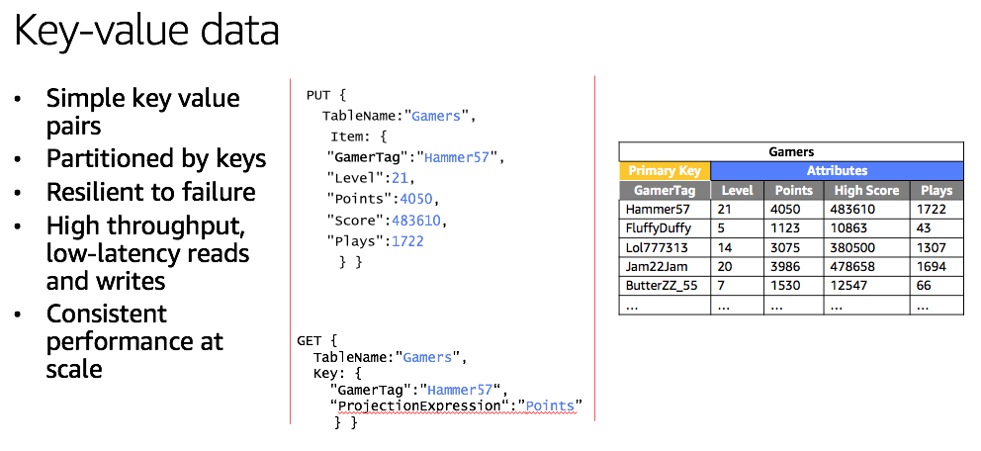
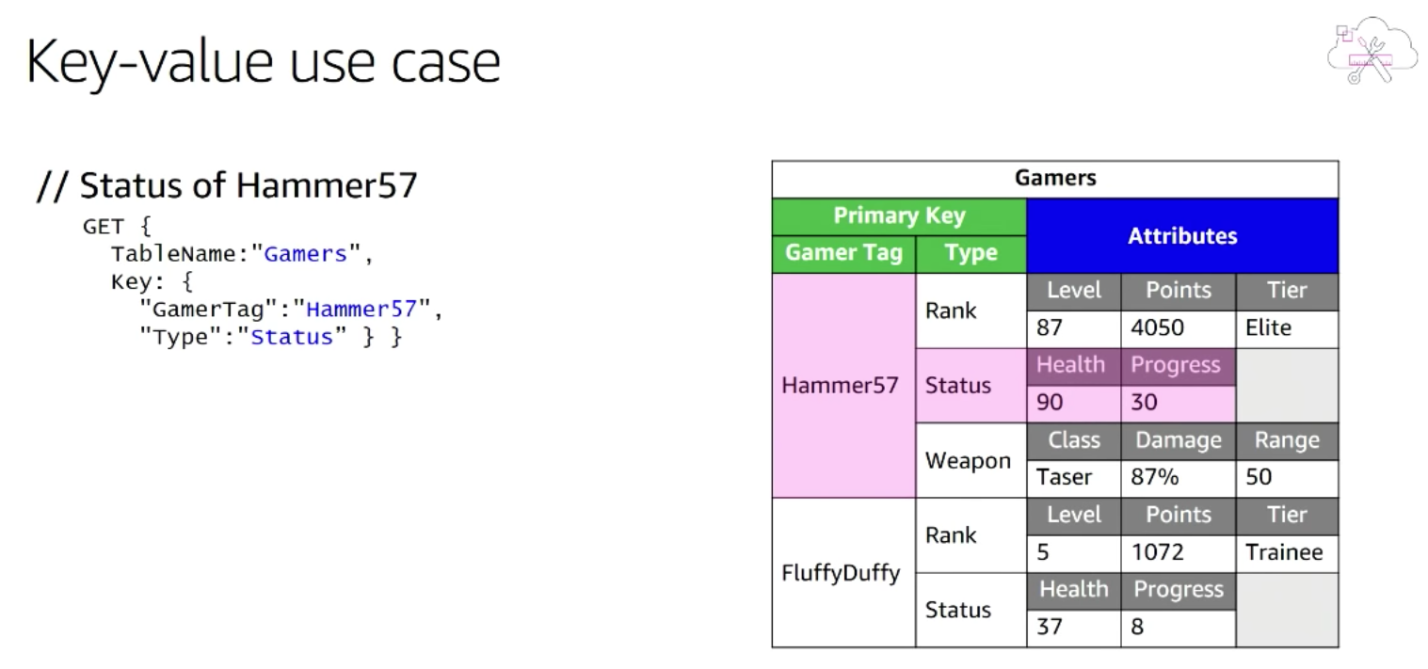
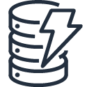
Common data categories and use cases
Relational
Key-value
Referential integrity, ACID transactions, schema- on-write
High
throughput, low-latency reads
and writes, endless scale
Common Use Cases
Lift and shift, ERP, CRM, finance
Real-time bidding, shopping cart, social, product catalog, customer preferences
AWS
Service(s)
Aurora, RDS
DynamoDB
Notes:
CONSISTENT PERFORMANCE AT SCALE (VideoGame need to behave the same way with 100.000 users or 100.000.000 users)
Need to know immediately a player status. Different the way we interact. A simple GET and it works extremely fast.
Also when you get different information with a specific TAG that GET different key value. It does not make difference between 100.000 or 100.000.000 of records. This because you can partition very easily.

Slide 18
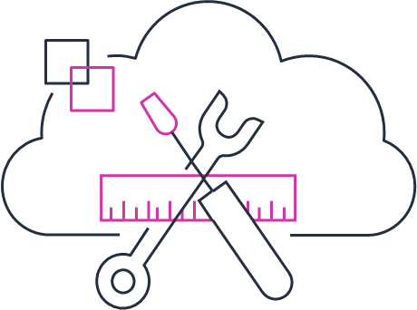

Amazon DynamoDB Fast and flexible key value database service for any scale
Comprehensive security
Global database for global users and apps
Performance at scale
Serverless
Consistent, single-digit millisecond response times at any scale; build applications with virtually unlimited throughput
No server provisioning, software patching, or upgrades; scales up or down automatically; continuously backs up your data
Encrypts all data by default and fully integrates with AWS Identity and Access Management for robust security
Build global applications with fast access to local data by easily replicating tables across multiple AWS Regions
Notes:
More than a hundred thousand AWS customers use Amazon DynamoDB.
Amazon's internal Amazon DynamoDB usage exceeds 10 trillions (10 mila miliardi) of requests per day, peaking at over 20 million requests per second.

Slide 19
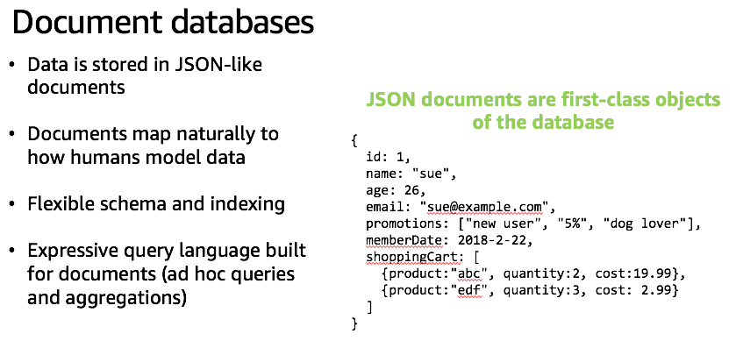
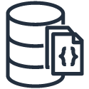
Common data categories and use cases
Relational
Key-value
Document
Referential integrity, ACID transactions, schema- on-write
High
throughput, low-latency reads
and writes, endless scale
Store documents and quickly access querying on any attribute
Common Use Cases
Lift and shift,
ERP,
CRM,
finance
Real-time bidding, shopping cart, social, product catalog, customer preferences
Content management,
user profiles, mobile
AWS
Service(s)
Aurora, RDS
DynamoDB
DocumentDB
Notes:
store, retrieve, and manage semi-structured data

Slide 20
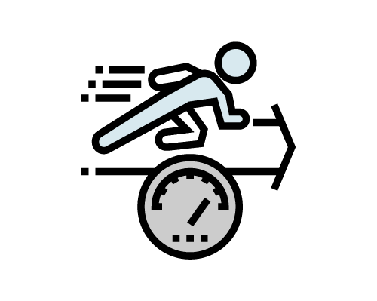



Amazon DocumentDB Fast, scalable, and fully managed MongoDB-compatible database service
Fast
Scalable
Fully managed
MongoDB compatible
Millions of requests per second with millisecond latency; twice the throughput of MongoDB
Separation of compute and storage enables both layers to scale independently; scale out to 15 read replicas in minutes
Managed by AWS: no hardware provisioning; auto patching, quick setup, secure, and automatic backups
Compatible with MongoDB 3.6; use the same SDKs, tools, and applications with Amazon DocumentDB

Slide 21
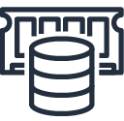
Common data categories and use cases
Relational
Key-value
Document
In-memory
Referential integrity, ACID transactions, schema- on-write
High
throughput, low-latency reads
and writes, endless scale
Store documents and quickly access querying on any attribute
Query by key with microsecond latency
Common Use Cases
Lift and shift, ERP, CRM, finance
Real-time bidding, shopping cart, social, product catalog, customer preferences
Content management, personalization, mobile
Leaderboards, real-time analytics, caching
AWS
Service(s)
Aurora, RDS
DynamoDB
DocumentDB
ElastiCache
Notes:
In memory data store.

Slide 22
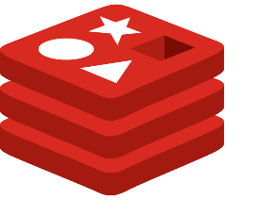

Amazon ElastiCache Redis and Memcached compatible, in-memory data store and cache
Redis & Memcached compatible
Extreme performance
Secure and reliable
Easily scalable
Fully compatible with open source Redis and Memcached
In-memory data store and cache for microsecond response times
Network isolation, encryption at rest/transit, HIPAA, PCI, FedRAMP, multi AZ, and automatic failover
Scale writes and reads with sharding and replicas

